Slide 1
How to submit exam?

Slide 2
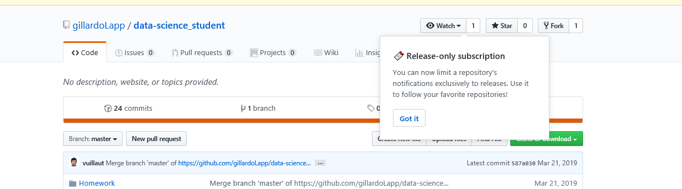
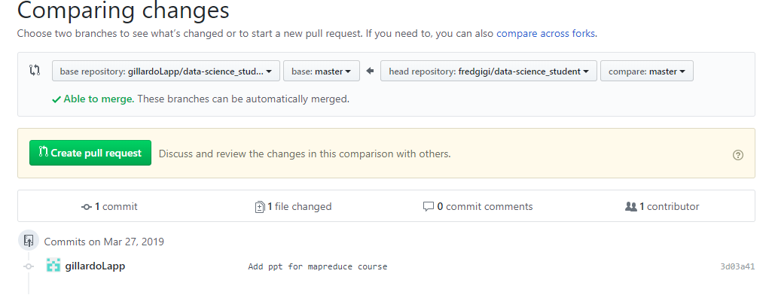
Fork the project « https://github.com/gillardoLapp/data-science_student» from github
Clone the fork in your local environment:
git clone https://github.com/%yourAccount%/data-science_student.git
Modify the project by adding the solutions ( git add, git commit, …)
Push the modification on your fork : git push
Ask for a pull request from Github:

